Slide 1
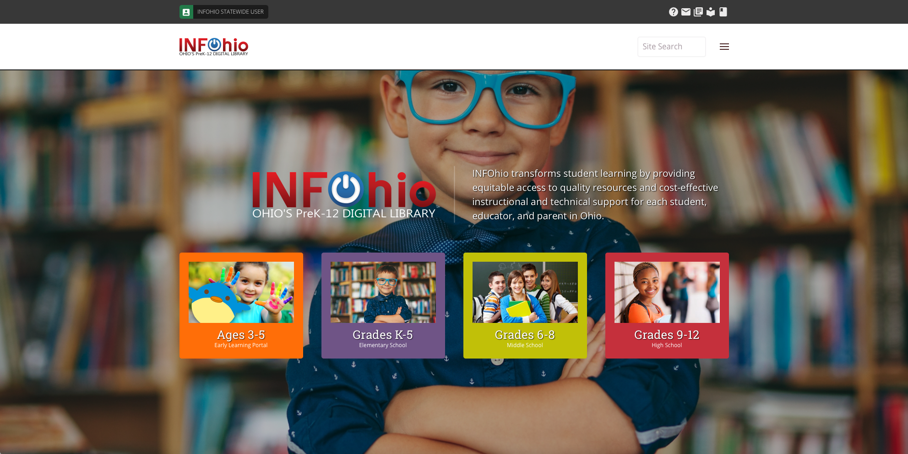
Notes:
So, let’s take a look at how to find Educator Tools where all the great Knovation and INFOhio created content is housed on our new INFOhio web site. Before we jump into investigating Educator Tools, I want to just point out a couple need to know items for the INFOhio website.
We listened to what you told us. The new site is designed to be easier to find what you need, both for students and teachers. There's more content up front with built-in menu options at the top and the bottom of most pages. The resources students and teachers use most are on the homepage or available in one to three clicks.
Click – With Geolocation added to our site, users in Ohio are automatically logged in using the statewide username and password. This provides access to all our digital content. Students and teachers at school will automatically be logged in with their school user name and password, but students at home may need to switch their log in to access their school library content in ISearch. Click the INFOhio statewide user button to change log ins.
For the vast majority of users, logging into the INFOhio website is no longer something they have to do. Even users at home who take their devices out of state now have simpler access to the site through a combination of geo-authentication, IP authentication, and cookies.
Here’s what happens in just a matter of seconds behind the scenes when you visit the INFOhio website:
We check to see if we recognize your IP address. If we recognize your IP address as coming from a school, we log you in as that school. If we recognize your IP address as coming from an ITC, we log you in as that ITC.
NO IP recognition? We check to see if we recognize our cookie on your device. If we recognize the cookie because you’ve logged into the INFOhio website from that device from your school before, we log you in as your school.
NO IP recognition and NO cookie? We check to see if we can tell you are in Ohio. For this to work, you need to have location services turned on in your browser. If we can tell that you are in Ohio, we log you in automatically as a statewide user.
It’s rare that we can’t recognize an IP, a cookie, or your state, but if that happens, you’ll be prompted to log in as soon as you try to access a password-protected resource.
If you are logged in as a statewide user and you want to log in as your school so that you can use your school’s version of ISearch, mouse over INFOhio Statewide User. It will wobble to catch your attention and it will change to “Click here to switch your login.” Then you can enter your school’s INFOhio username and Password. If you don’t know it, click “Find Password” and start typing your school name in the box that appears. Your school username and password will appear on the screen and you can click Login.

Slide 2
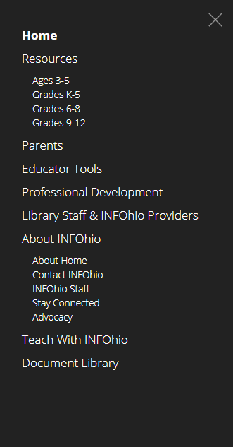
Main Menu
Notes:
The main menu is on the upper right hand side of the site. Click on it to be directed to additional pages such as Educator Tools. If you would like to follow along open a browser and go to https://www. Infohio.org and select the hamburger menu and Educator Tools.

Slide 3
Educators
Notes:
Scrolling down further on the home page will lead to the Educator Resources from INFOhio. Teachers have a choice here and can connect with our Educator Tools content management system to find lesson plans and flyers. They can also choose to read a blog post or catch up on INFOhio’s advocacy. And our school librarians will find information about automation and support in this area.

Slide 4
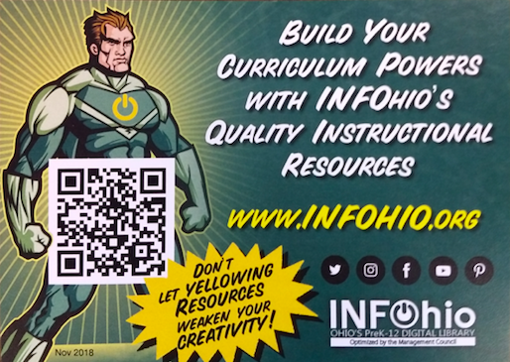
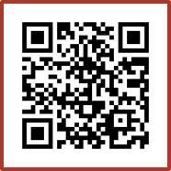
You already have FREE access
to Educator Tools!
Notes:
[log into Google so Google classroom option opens]
With INFOhio, finding high quality, digital, instructional materials that you can use to improve student learning is quick and easy. Educator Tools includes lesson plans, student learning activities, assessments and other support materials for educators. Help busy teachers maximize their minimal planning time with INFOhio’s Educator Tools. Follow the QR code to learn more!
Use your phone to snap a pic of that QR code you see on your screen. That will take you to Educator Tools

Slide 5
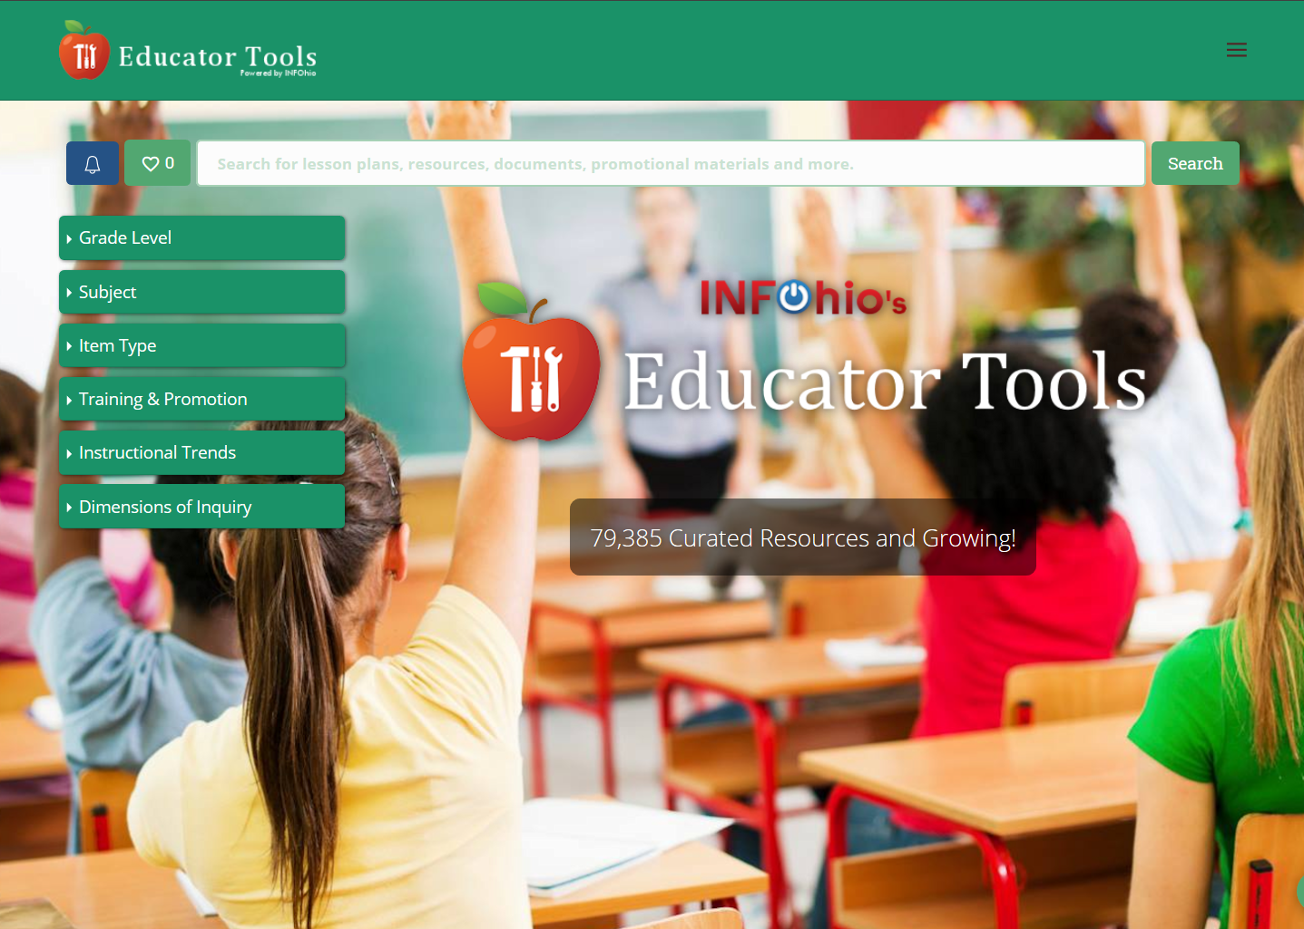
www.infohio.org/educator-tools
Notes:
Educator Tools, powered by INFOhio, now includes more than 70,000 teacher-approved lesson plans, best practices, and other instructional materials, from the Knovation Content Collection to support personalized learning, project-based learning, and the inquiry process. The Knovation Content Collection is curated by education professionals who evaluate the resources against a 127 point rubric.
INFOhio’s Educator Tools gives Ohio educators easy and free access to standards-aligned learning resources from exemplary K-12 content publishers. In INFOhio’s Educator Tools, you’ll find the best-in-class learning resources for all grades, all subject areas, and all learning resource types to differentiate and personalize learning for your Ohio PreK-12 students.

Slide 6
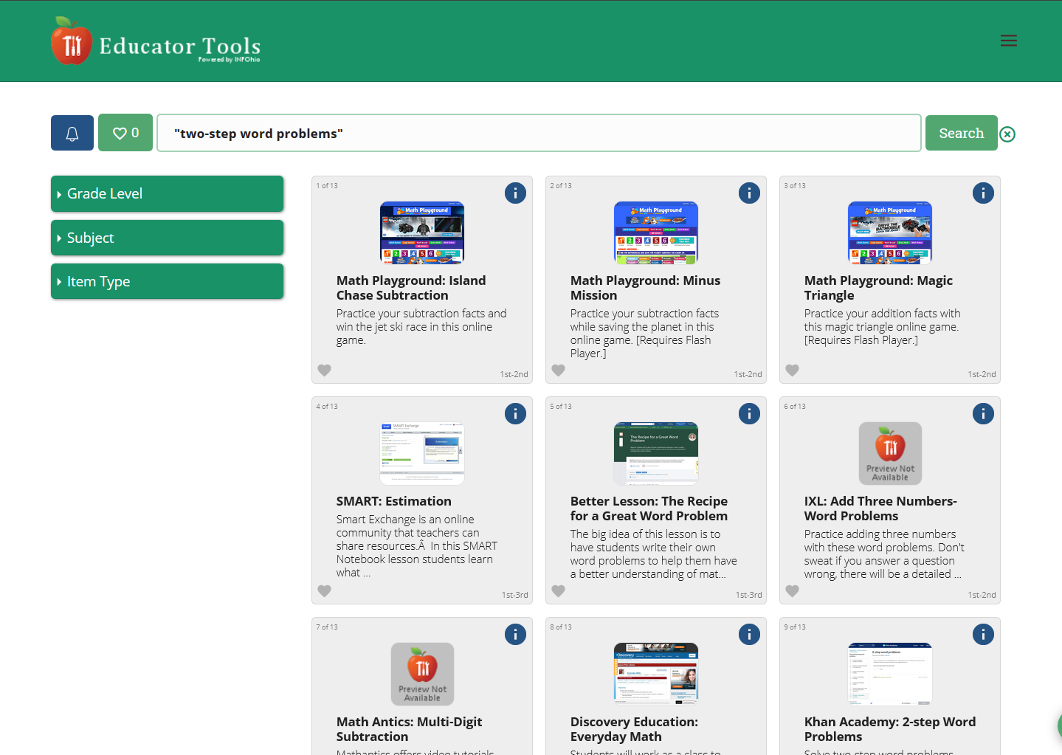
Educator Tools
Notes:
Let’s say I teach third grade and I’m looking for approaches to teaching students to solve two step word problems . Note you can also use the plus sign (+) or the minus sign (-) for searching terms.
I’ve put quotes around my search so that Educator Tools will look for this exact phrase.

Slide 7
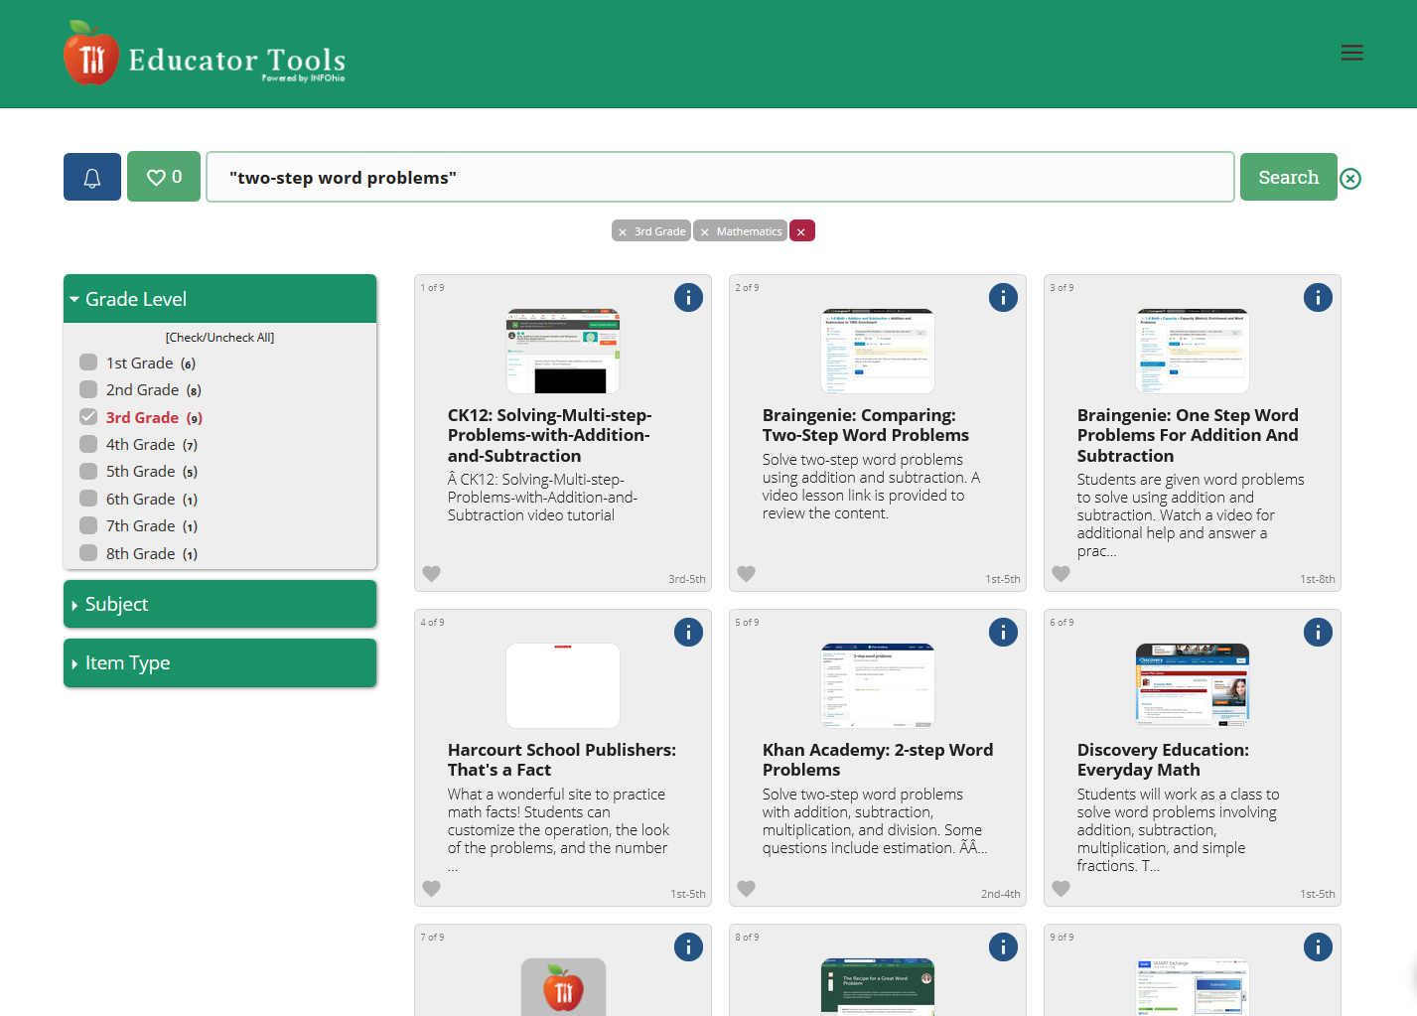
Learn more about the resource.
Notes:
I’m going to click <click>the More Info, or “i-button,” that I see in the upper right corner for the Khan Academy resource.

Slide 8
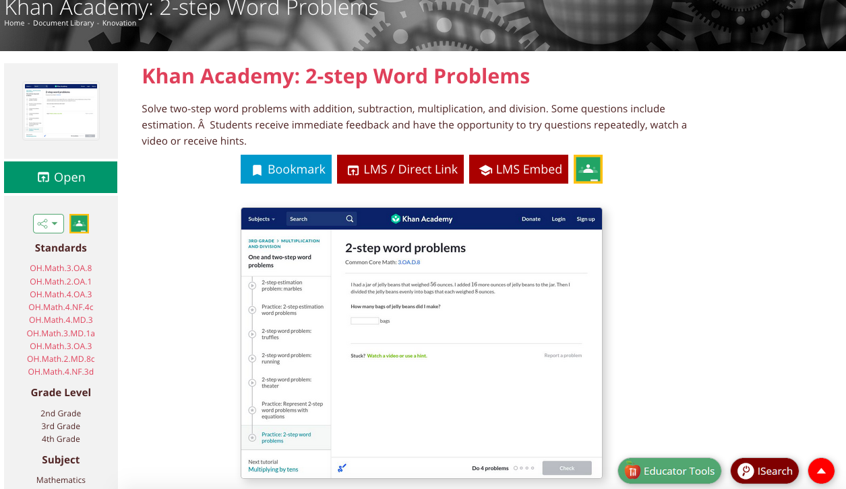
Find lesson plans and more that meet
Ohio Learning Standards.
Notes:
Here I get a full description of the resource, some standard codes, and links to that I can use to either open the resource or save it to my learning management system. If I click <click> a standard code…

Slide 9
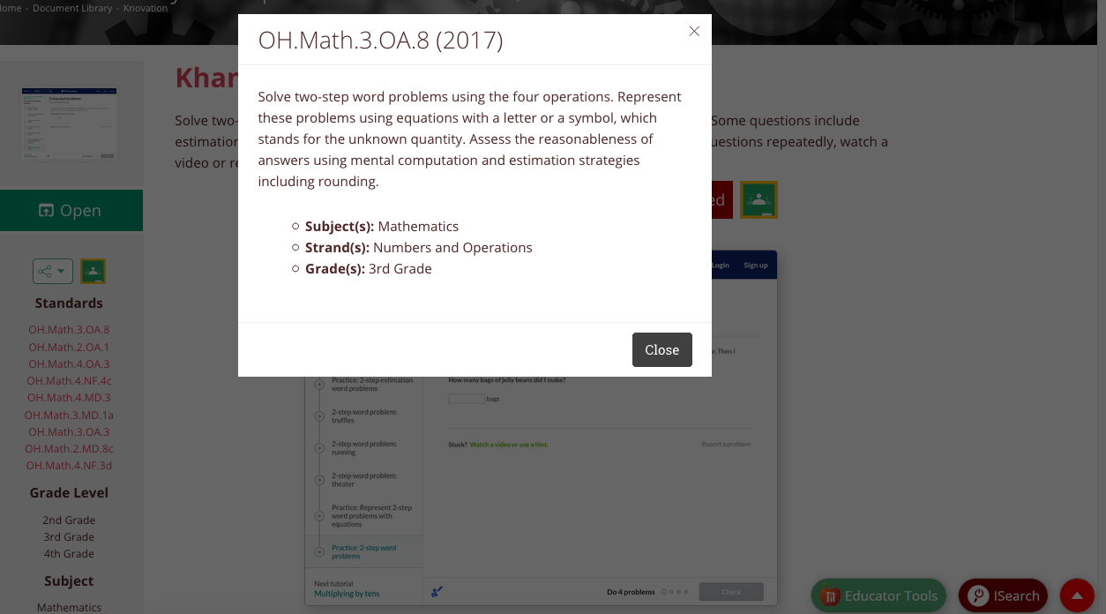
Find lesson plans and more that meet
Ohio Learning Standards.
Notes:
I get info about that standard. This resources has been aligned to this particular standard.

Slide 10
Save to your Learning Management System or Google Classroom.
Notes:
If I scroll down just a little on the more info page, I can click the LMS/Direct Resource Link or the Google Classroom link. The LMS link opens this little permalink box. You can copy and paste that link into a learning management system and it will take you or your students straight to the resource.The green button will take you directly to Google Classroom. I’m going to go back and explore my results a little more…

Slide 11
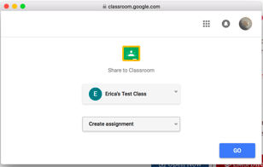
Save to your Learning Management System or Google Classroom.
Notes:
Select your class and choose your action. In this case, I chose “Create assignment”

Slide 12
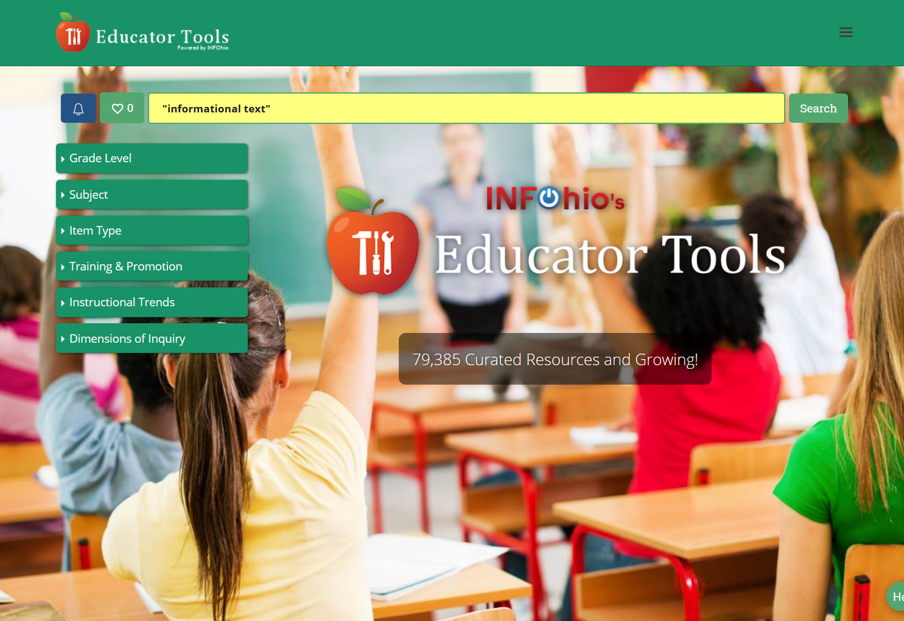
Educator Tools
Notes:
Let’s say I teach second grade and I’m looking for approaches to teaching students how to read informational text. I’ve put quotes around my search so that Educator Tools will look for this exact phrase.

Slide 13
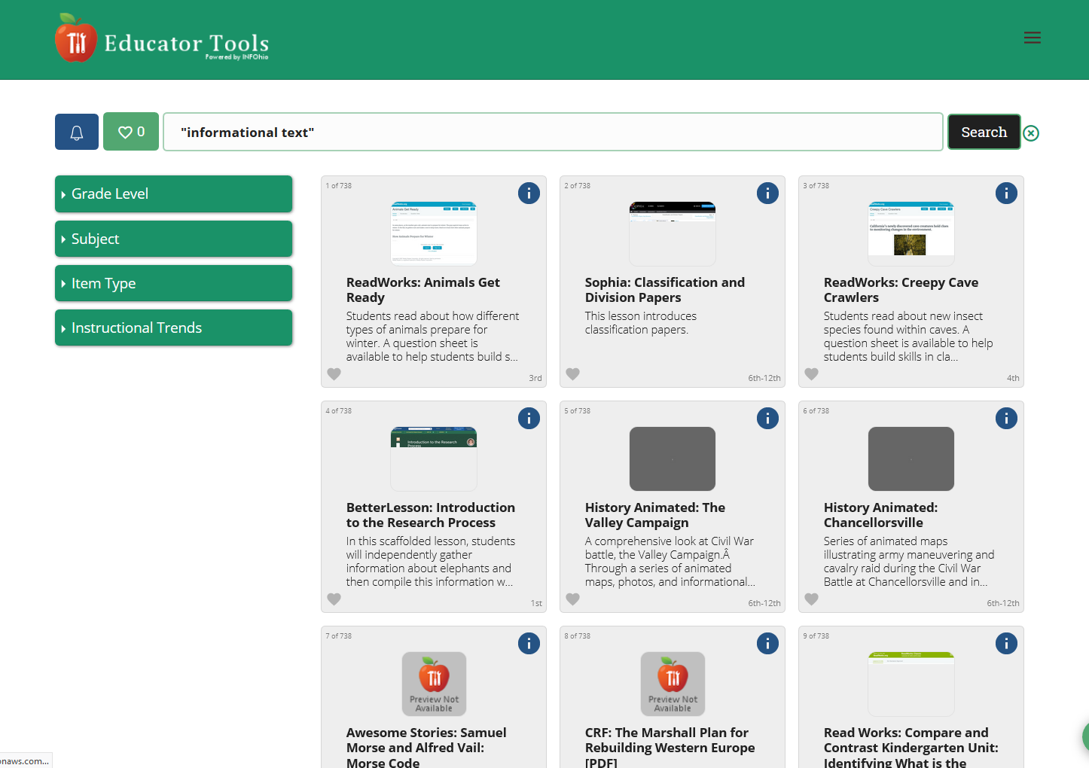
Quickly narrow results to the
materials you need.
Notes:
I got about [###] results so I want to narrow my results a little. <click>To do that, I’m going to click that Item Type limiter…

Slide 14
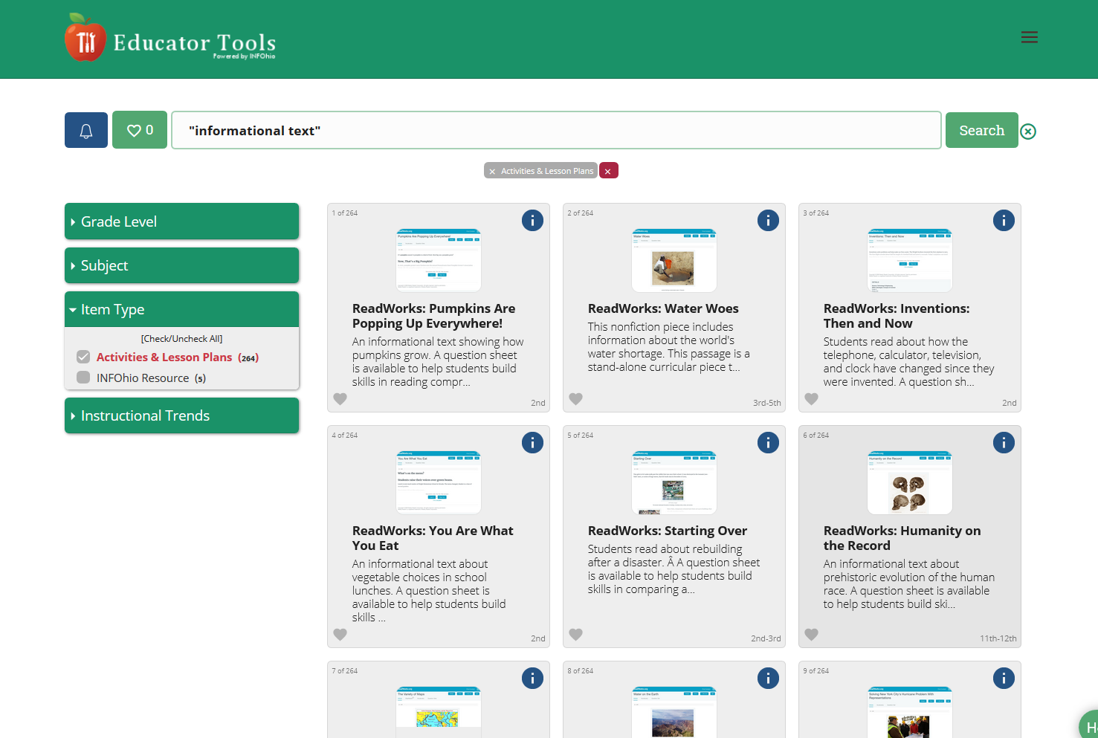
Quickly narrow results to the
materials you need.
Notes:
And now I’m checking that box next to activities & lesson plans. You’ll see that any limiters you click will appear just under the search box in the center of your screen <click>. You can always get rid of any limiters you apply by clicking the “X” next to that limiter, or you can get rid of all your limiters at once by clicking that red “X”.

Slide 15
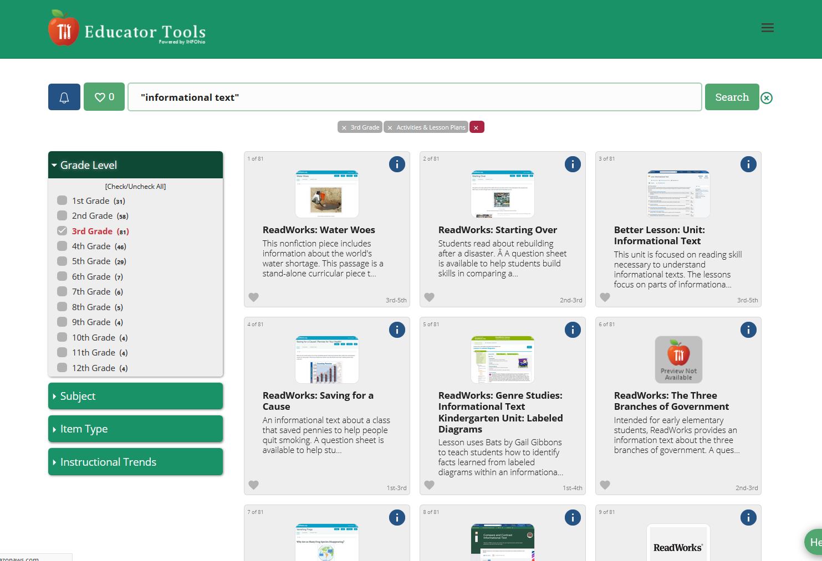
Quickly narrow results to the
materials you need.
Notes:
I want to narrow my results a little more. This time, I’m going to use the Grade Level limiter.
<click>And now I’m checking that box next to 3rd.
In this case, I’m reading through those teasers descriptions and several of them sound really good.

Slide 16
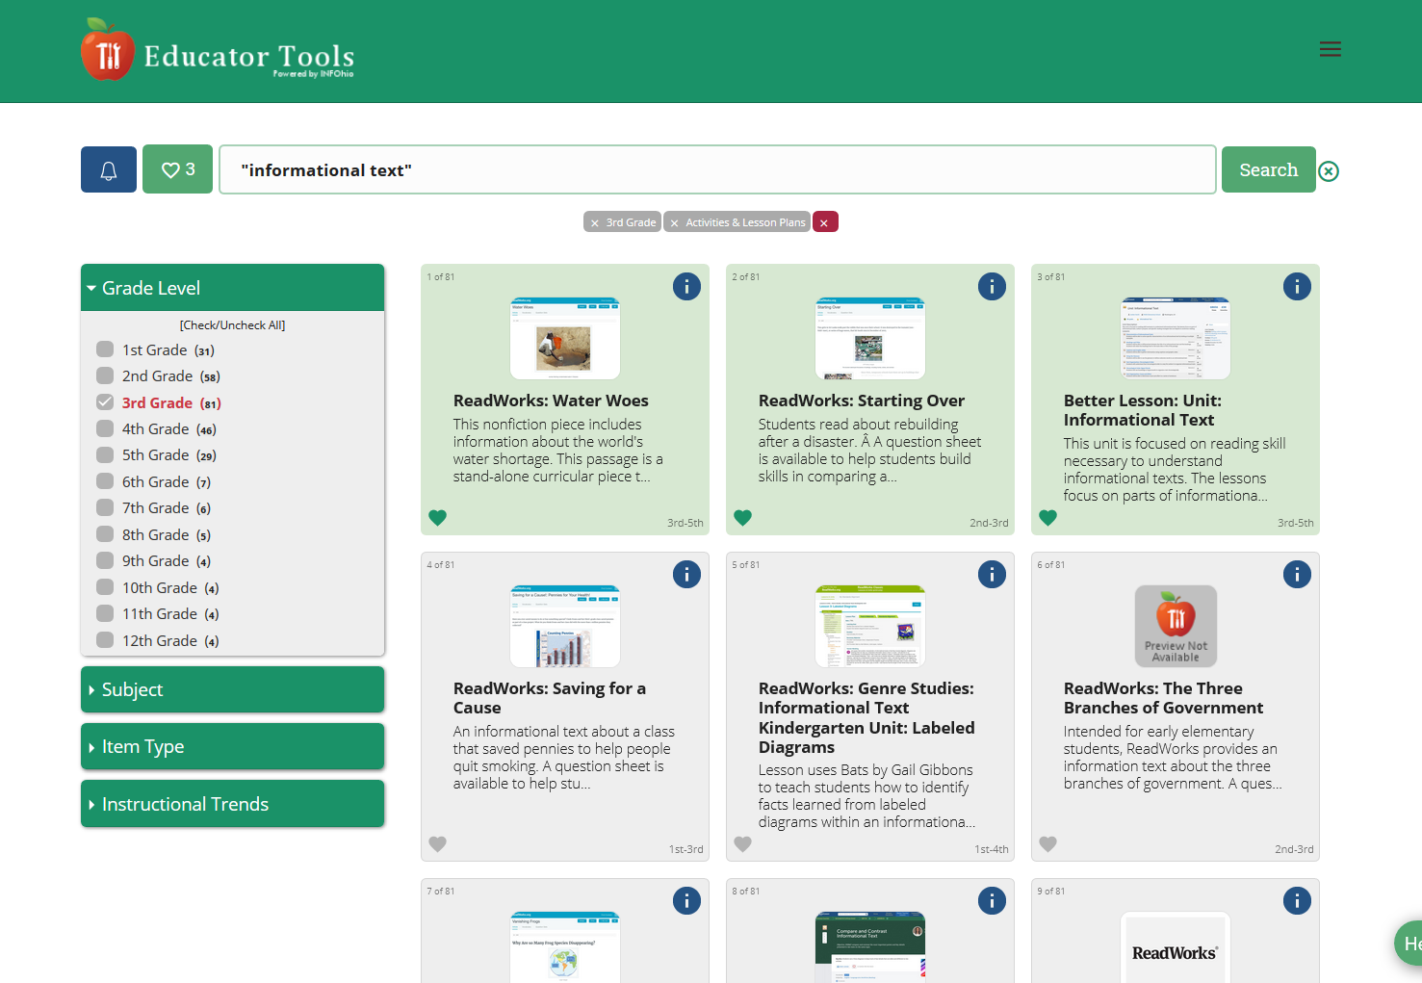
Save your favorites.
Notes:
Some look really good. In fact, I don’t want to lose them. <click> I’m going to click that heart icon in the lower left corner of some of those results. <click> Then I’m going to click that heart icon near the top left corner of the page.

Slide 17
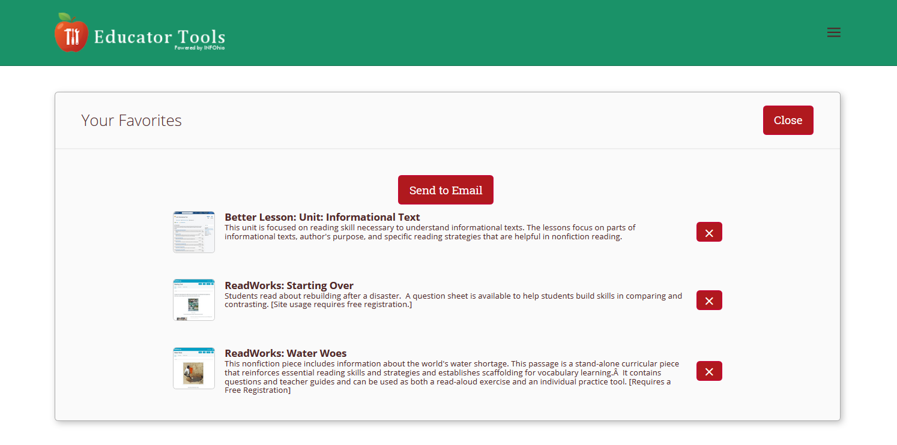
Email your favorites to yourself.
Notes:
Notifications
When I do that, I get a list of my “favorites,” those items I’ve clicked the heart for. I can click Send Email, enter my email address in the box that appears, and send myself some perma-links to these items so I can get back to them later.
Your “favorites” are really only saved temporarily. Make sure you email all your favorites to yourself at the end of each session so that you’ve got them saved to your email.

Slide 18
Get notified.
Notes:
If you click on the blue bell next to the favorites heart, you also have a chance to be notified when new items are added to Educator Tools.

Slide 19
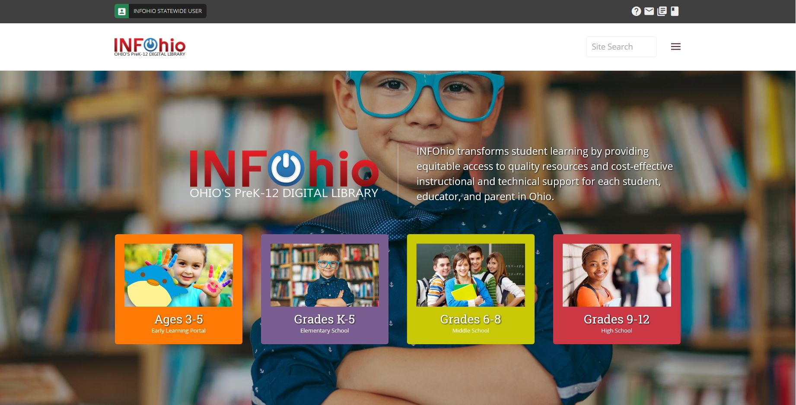
INFOhio ♥ Educators
Notes:
So it’s all there, free for you to use.

